Slide 1

Welcome to the contract monthly claim system
Daniel Luke James
PROG6212 POE
ST10393280

Slide 2




Why Choose Our System?
Simple & Fast Claims
Real-Time Notifications
Secure & Transparent
Submit claims with just a few clicks and track the approval process in real –time.
Stay informed with instant notifications when claims are processed or approved.
Your data is securely managed, providing full transparency through the process.

Slide 3
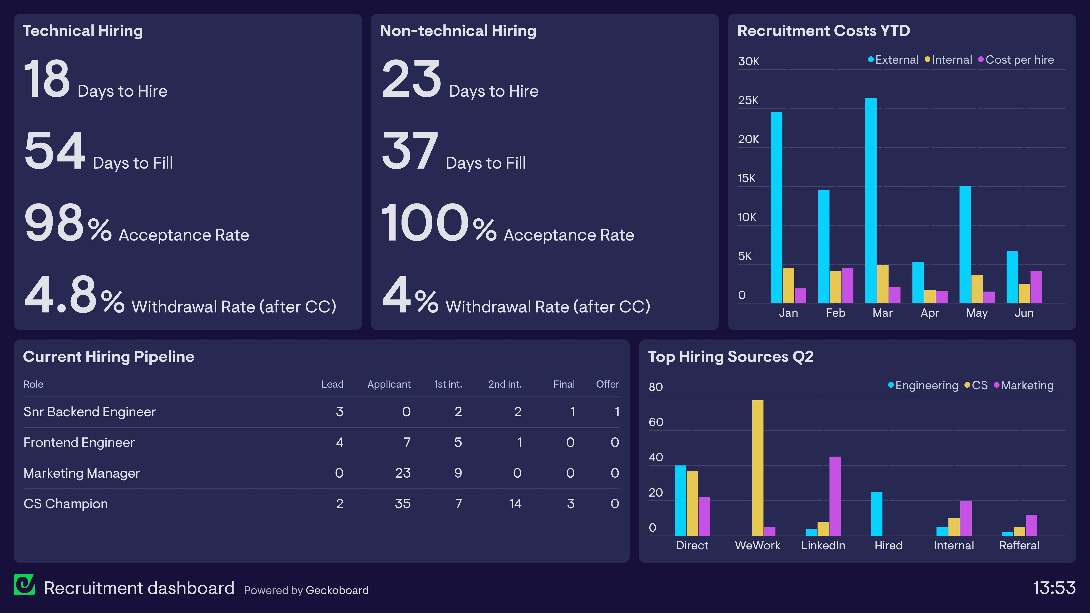
users & dashboards
HR User & Dashboard
Lecturer User & Dashboard
Coordinator User & Dashboard
1
2
3

Slide 4
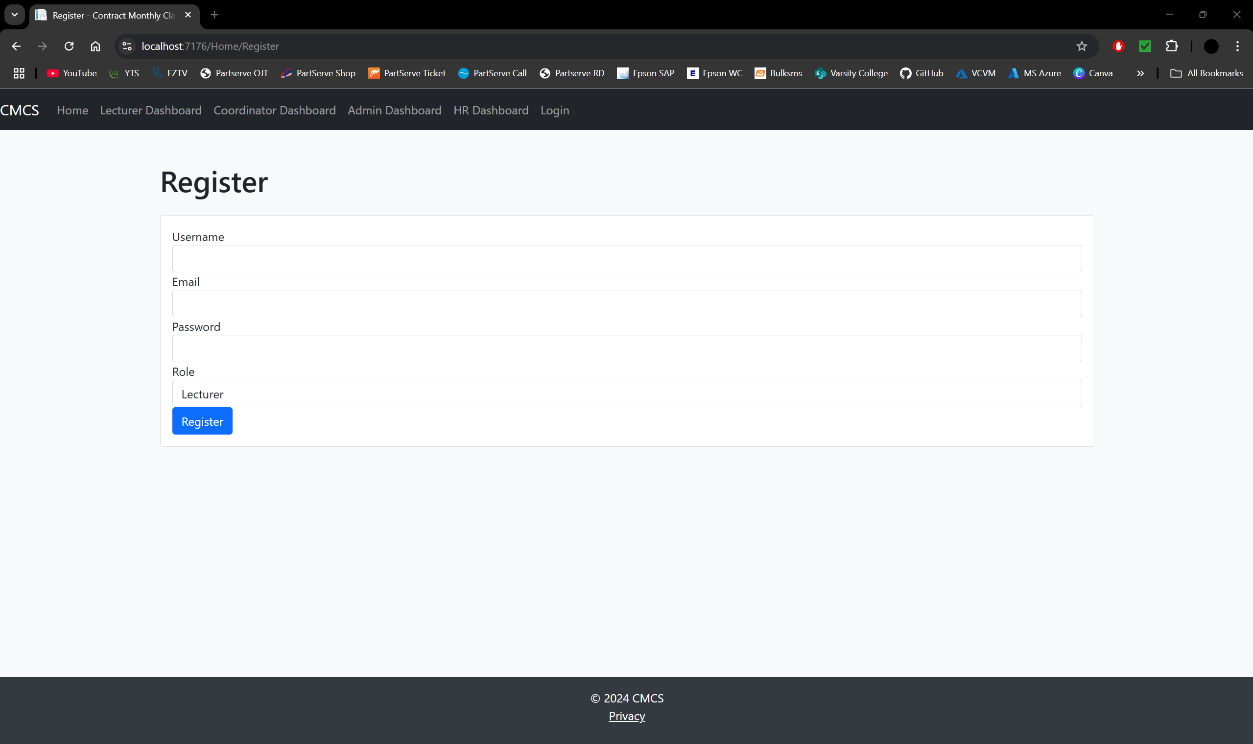
Register Page
Each user must first create a personal profile in order to access the system. Users will need to supply a username, email address, and strong password when registering. Depending on their intended use, users must also choose their preferred role inside the system, such as administrator, viewer, or contributor.
A simplified and effective experience is produced by this customized approach, which guarantees that users have access to features and permissions that correspond with their role.

Slide 5
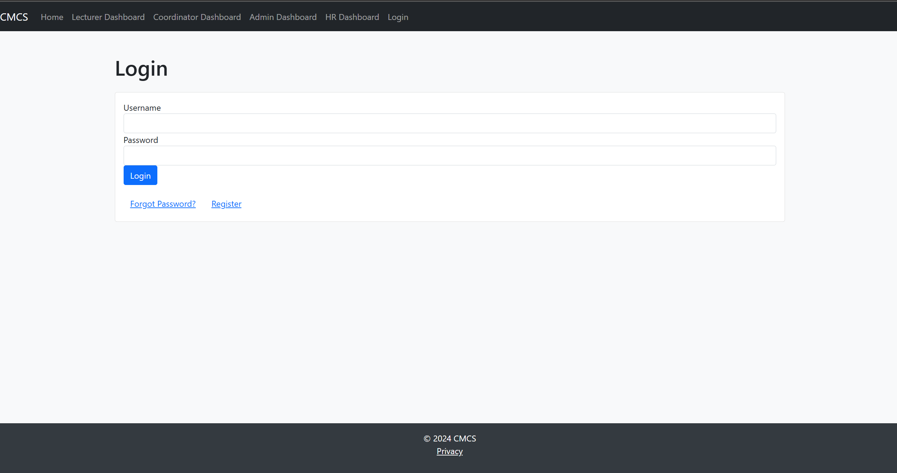
Login Page
Using their individual username and password, users classified as HR staff, instructors, and coordinators can access the system. Each user has access to features and resources that are particular to their role after logging in.
Role-based access guarantees a safe and effective setting where individuals may carry out their assigned tasks with ease.

Slide 6
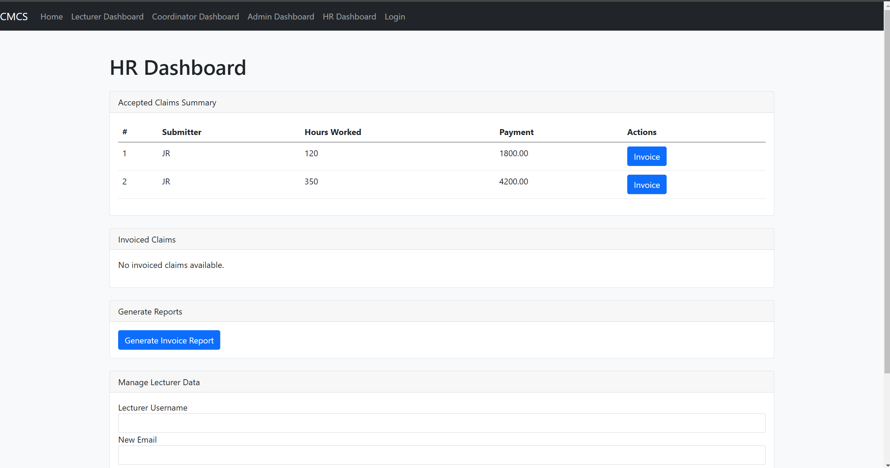
HR Dashboard
For accelerated payment processing, the HR dashboard will have tools to instantly create invoices or reports that summarize accepted claims. In addition to ensuring accuracy in financial transactions, this automation will lessen administrative work.
The dashboard will also include capabilities for managing lecturer data, making it simple for HR staff to change personal data like contact information or other pertinent documents. These capabilities will help efficient management of lecturer-related responsibilities, improve efficiency, and preserve correct records.

Slide 7
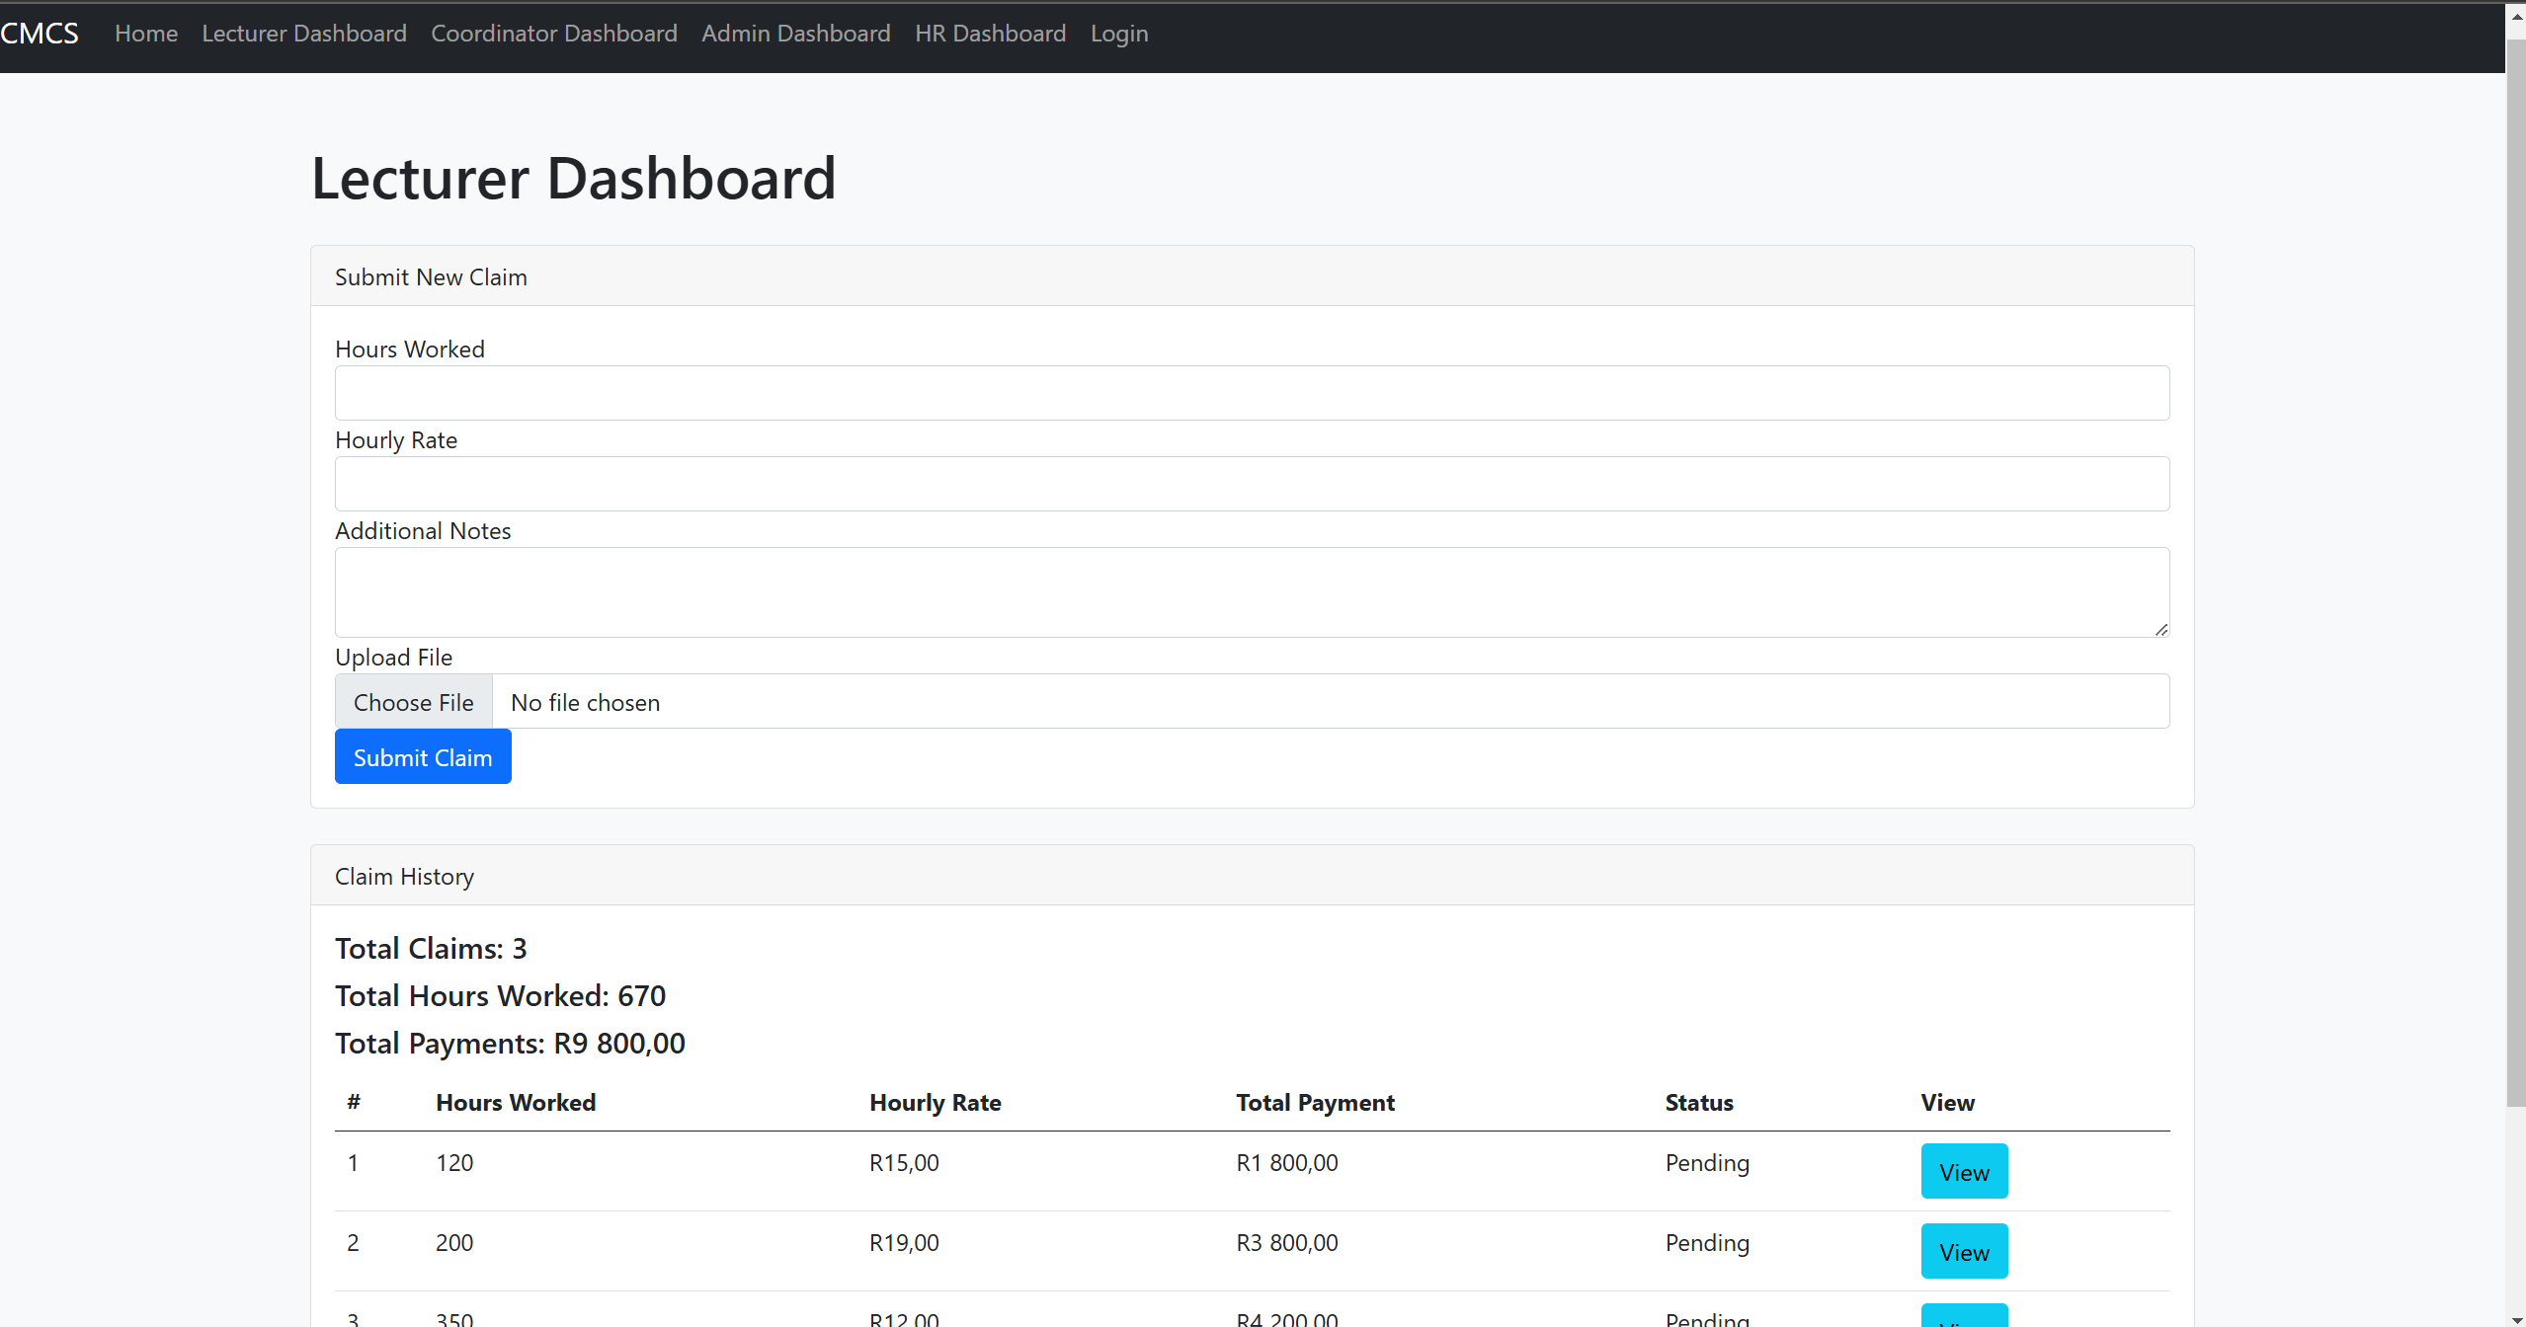
Lecturer Dashboard
A function to automate the claim submission process will be included in the lecturer dashboard, allowing instructors to quickly enter their hourly rate and number of hours worked and submit claims with little effort. To provide prompt and precise results, an auto-calculation tool will be incorporated to determine the final payment based on the hours worked and the hourly rate given.
To guarantee data entry correctness, the system will also include validation tests, such as confirming that all essential fields are filled out and that the entered values fall within permissible limits. These features will preserve data integrity while streamlining the claim procedure.

Slide 8
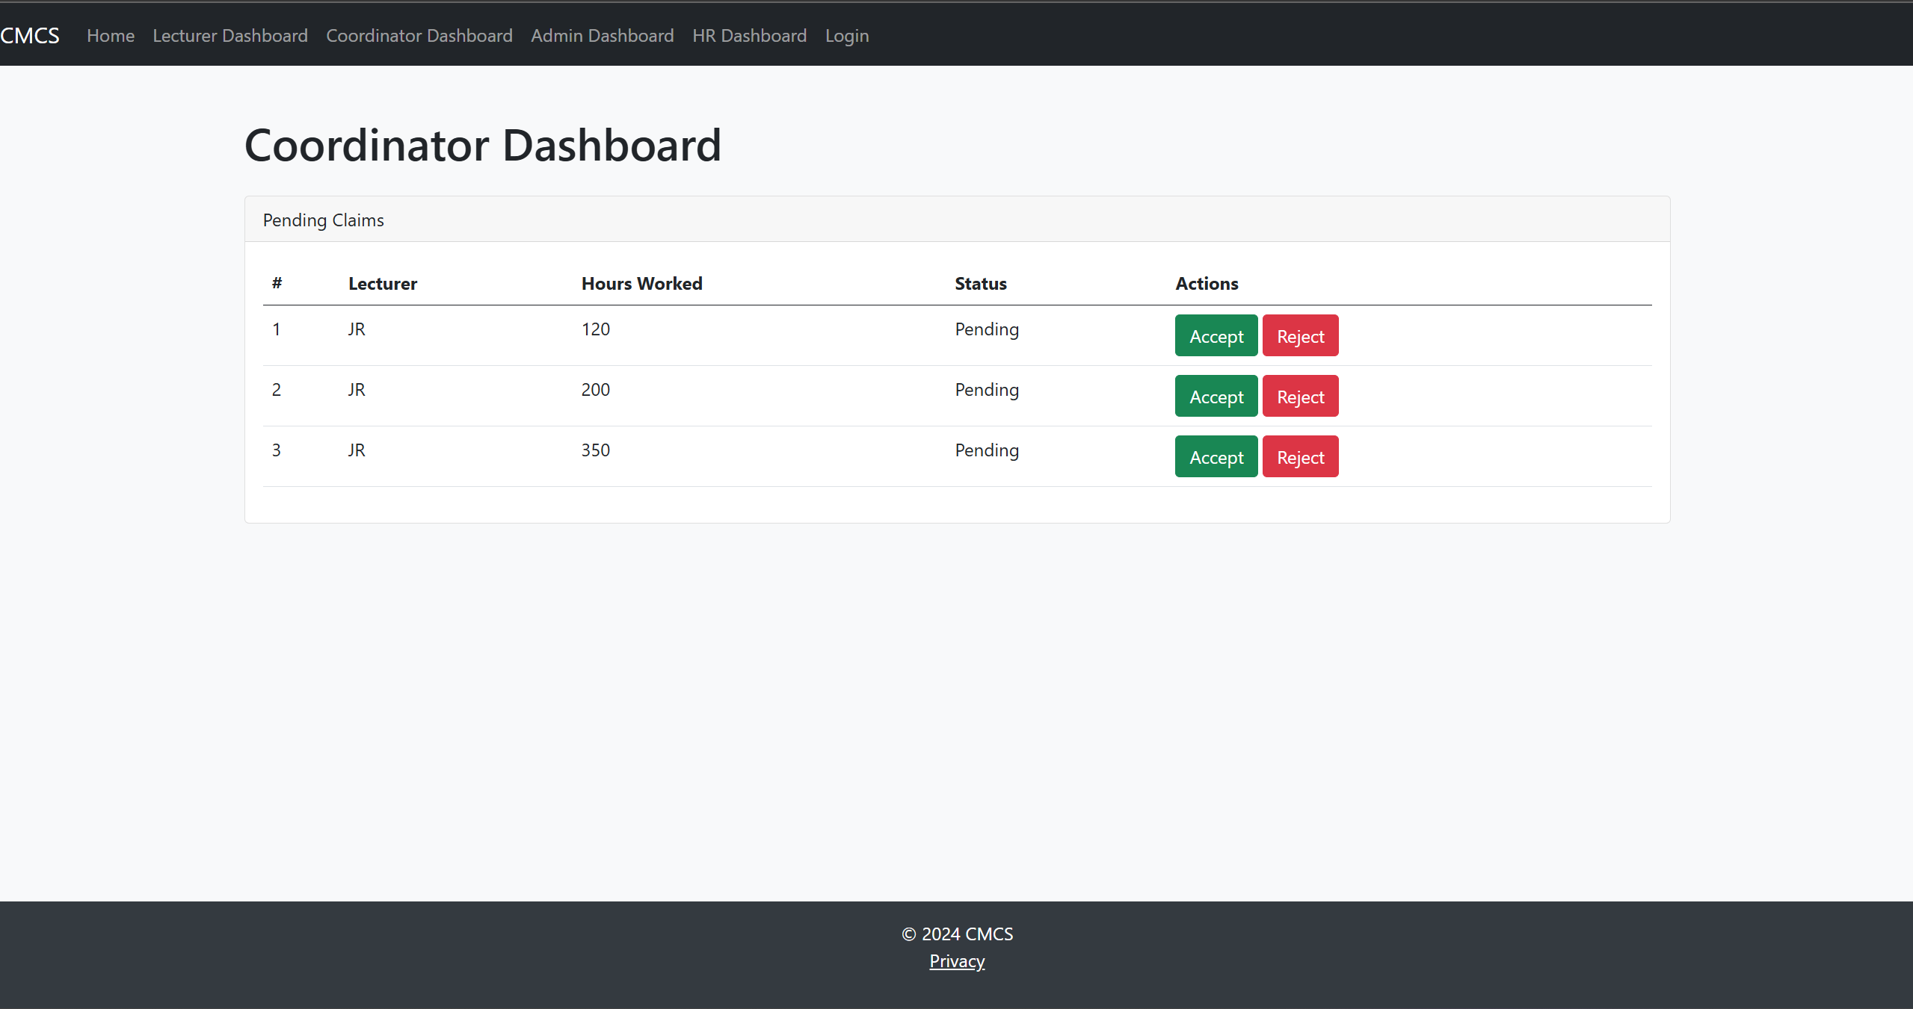
Coordinator Dashboard
To expedite the evaluation and processing of filed claims, the coordinator dashboard will include an automated method for claim verification and approval. The system will automatically compare submitted claims to predetermined standards, including hourly rates, the number of hours worked, and other organizational policies. Any inconsistencies or information gaps will be noted for additional examination.
Approval protocols will be put in place to increase efficiency, making it simple for coordinators to examine and approve claims or ask for clarifications as necessary. These procedures will provide openness and uniformity throughout the process by incorporating explicit steps for verification, escalation (if required), and final approval.

Slide 9

Privacy policy page
To safeguard user data, the system will abide by a thorough privacy policy. All financial and personal data will be processed and stored securely in accordance with the relevant data protection laws.
Based on user roles, access to sensitive data will be limited to maintain confidentiality and stop unwanted access. Users will be in charge of their data and can request that it be updated or deleted as necessary.

Slide 10
THANK YOU

